Slide 1
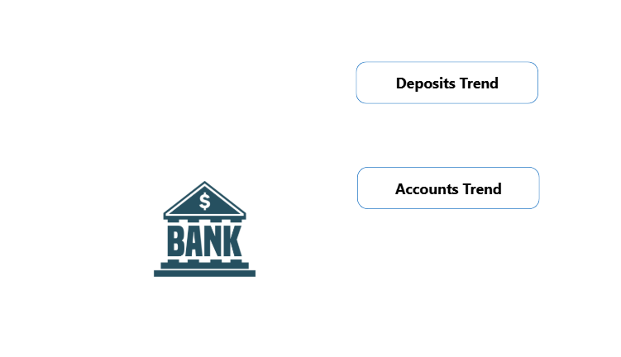
Landing Page

Slide 2

Deposit Analysis
Period From slicer –Year, Month
Period To slicer –Year, Month
Line of Business
Group
Region
Prod
Deposits by Week
Area chart
X axis – Week ( WK1, WK2, WK3………)
Y axis - Total balance

Slide 3
Account Analysis
Period From slicer –Year, Month
Period To slicer –Year, Month
Line of Business
Group
Region
Prod
Accounts by Week
Area chart
X axis – Week ( WK1, WK2, WK3………)
Y axis - Total Accounts

Slide 4
Formula
Below formulas should work based on Period From and Period To selection
Total Deposits -> Sum(Balance)
Total Accounts -> Sum(Accounts)
For eg:
Period From – 2022, jan
Period To – 2022, Mar
Then x – axis should be WK1, WK2……WK14
For eg:
Period From – 2022, jan
Period To – 2022, Feb
Then x – axis should be WK1, WK2……WK10
It should show all the weeks between the Period form and Period To selection.

